Slide 1
CS 419: Production Rendering Transparency
Eric Shaffer

Slide 2
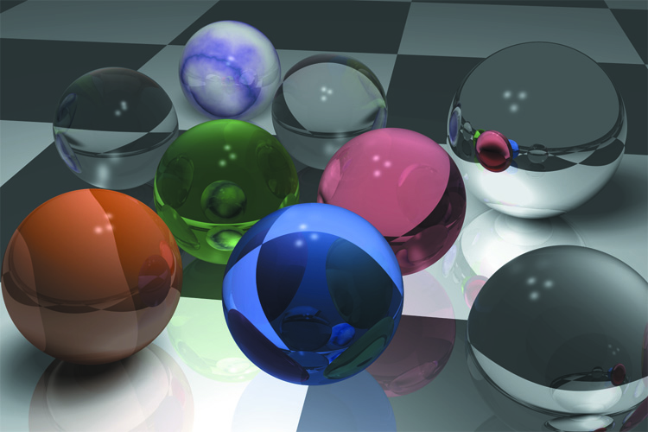
Transparency
Transparent media allow light to pass through them
Glass, clear plastic, air, water are all transparent media
A subset of materials know dielectrics which are also insulators
Any guesses as to how water can be on that list?

Slide 3
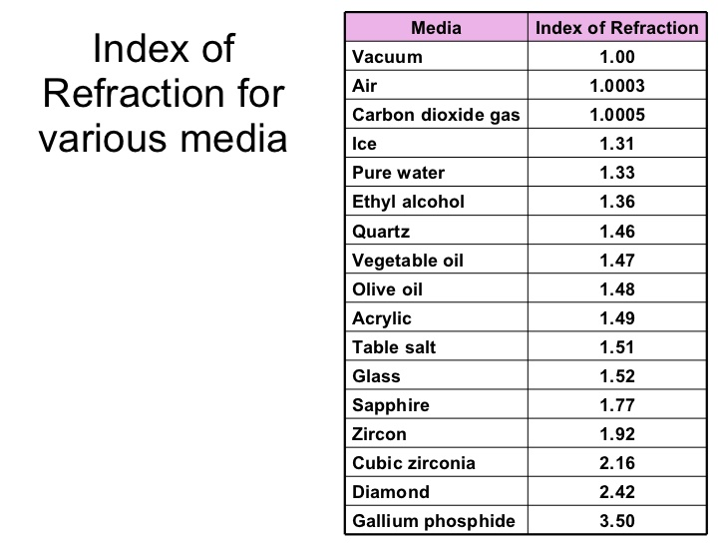
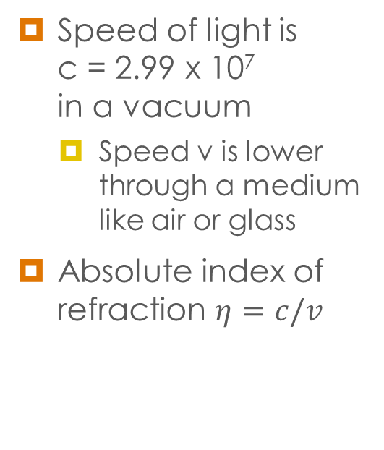
Index of Refraction
Speed of light is c = 2.99 x 10⁷ in a vacuum
Speed v is lower through a medium like air or glass
Absolute index of refraction $η=c/v$

Slide 4
Surface Physics
When a ray w_{o} hits the surface of a transparent medium
A reflection ray r is generated
A transmission ray t is generated
If the boundary is optically smooth
w_{o}, t, and r are in the plane of incidence
Transmission will be perfectly specular
Optically smooth → rough features much smaller than light λ

Slide 5
Surface Physics
Relative Index of Refraction isη=η_{in}/η_{out}
Need to find a direction for the ray t using Snell’s law

Slide 6
Surface Physics
t is bent away from ω_{o}
η_{out}<η_{in} it bends towards the normal
η_{out}>η_{in} it bends away from the normal

Slide 7
Total Internal Reflection

Slide 8
Total Internal Reflection
As the transmission direction approaches the surface
The energy in the transmission ray decreases
The energy in the reflection ray increases
When θ_{i} exceeds the critical angle
The transmission ray ceases to exist
All the energy is contained in the reflection ray
You can test for that condition

Slide 9
The Illumination Model
Illumination model is similar to that for reflection
But indirect component includes transmission plus reflection
Instead of a BRDF we have a BTDF
bidirectional transmission distribution function

Slide 10
The Illumination Model

Slide 11
The Illumination Model
Allow recursion level of at least 2
Why?
At each hit point, can generate 0, 1, or 2 rays
Can end up with large number of secondary rays
Long rendering times

Slide 12
The Illumination Model
Since we model perfect refraction
We do not need to compute an integral
Radiance changes as light crosses the boundary
k_{t} is the transmission coefficient [0,1]

Slide 13
The Illumination Model
Need to keep track of the direction of radiance transfer
Choose of refraction terms correctly
At point a radiance transfer is from inside to outside
At point b the transfer is from outside to inside

Slide 14
Practical Considerations
Total internal reflection can happen when a ray strikes a transparent surface from the inside or outside
When this happens, reflection coefficient should be set to 1.0
On a ray hit from inside an object, to compute t
reverse the normal direction
invert the relative index of refraction
change sign of cos θ_{i}

Slide 15
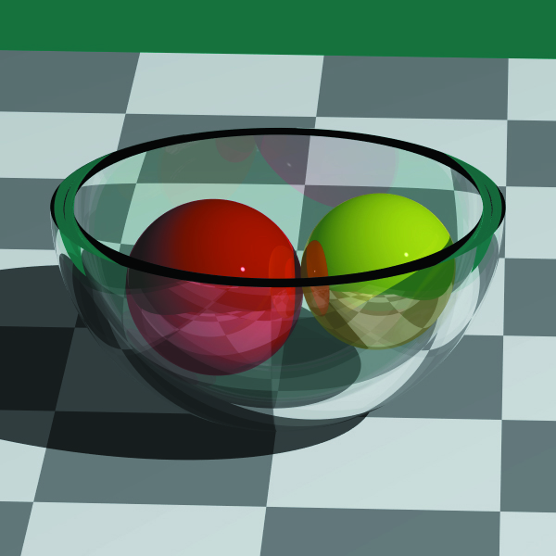
Example

